Slide 1
Feature Selective Anchor-Free Module for Single-Shot Object Detection
Chenchen Zhu, Yihui He, Marios Savvides
Carnegie Mellon University
06/17/2019

Slide 2
Overview
Background
Motivation
Feature Selective Anchor-Free (FSAF) Module
General concept
Network architecture
Ground-truth and loss
Online feature selection
Experiments
Qualitative Results

Slide 3
Overview
Background
Motivation
Feature Selective Anchor-Free (FSAF) Module
General concept
Network architecture
Ground-truth and loss
Online feature selection
Experiments
Qualitative Results

Slide 4
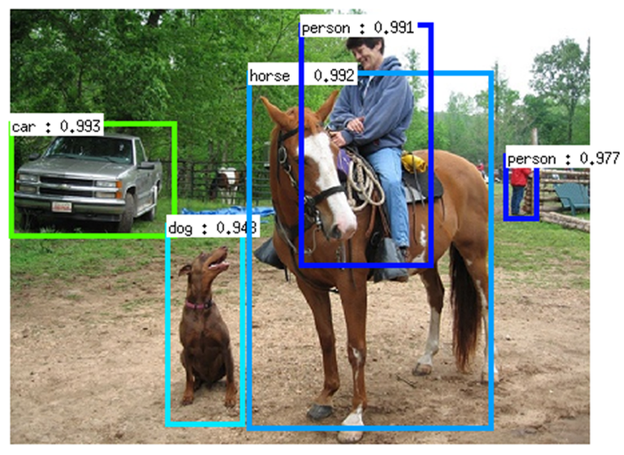
Background
A long-lasting challenge: scale variation

Slide 5
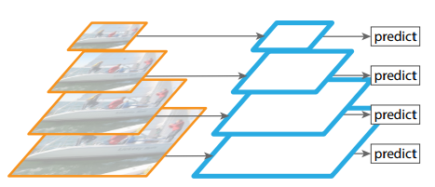
Background
Prior methods addressing scale variation
Image pyramid

Slide 6
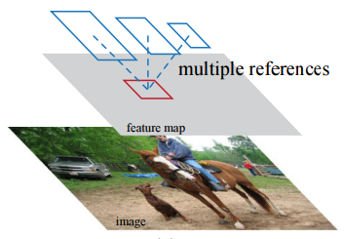
Background
Prior methods addressing scale variation
Anchor boxes [Ren et al, Faster R-CNN]

Slide 7
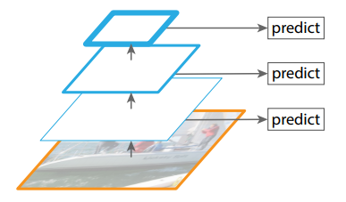
Background
Prior methods addressing scale variation
Pyramidal feature hierarchy, e.g. [Liu et al, SSD]

Slide 8
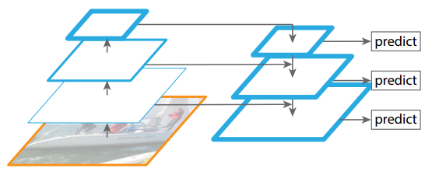
Background
Prior methods addressing scale variation
Feature pyramid network [Lin et al, FPN, RetinaNet]

Slide 9
Background
Combining feature pyramid with anchor boxes
Smaller anchor associated with lower pyramid levels
Larger anchor associated with higher pyramid levels
large
anchors
anchor-based branch
medium anchors
anchor-based branch
small anchors
anchor-based branch
feature pyramid

Slide 10
Overview
Background
Motivation
Feature Selective Anchor-Free (FSAF) Module
General concept
Network architecture
Ground-truth and loss
Online feature selection
Experiments
Qualitative Results

Slide 11
Motivation
Inherent limitations
Heuristic-guided feature selection
IoU-based anchor sampling
60x60
ad-hoc heuristics!
large
anchors
anchor-based branch
50x50
medium anchors
anchor-based branch
40x40
small anchors
anchor-based branch
feature pyramid

Slide 12
Motivation
Problem: feature selection by anchor boxes may not be optimal!
Question: how can we select feature level based on semantic information rather than just box size?
Answer: allowing arbitrary feature assignment by removing the anchor matching mechanism (using anchor-free methods), selecting the most suitable feature level.
Solution: Feature Selective Anchor-Free (FSAF) Module

Slide 13
Overview
Background
Motivation
Feature Selective Anchor-Free (FSAF) Module
General concept
Network architecture
Ground-truth and loss
Online feature selection
Experiments
Qualitative Results

Slide 14
FSAF Module
The general concept
anchor-based branch
FSAF module
anchor-free branch
instance
anchor-based branch
anchor-free branch
feature selection
anchor-based branch
anchor-free branch
feature pyramid

Slide 15
FSAF Module
Instantiation
Network architecture
Ground-truth and loss
Online feature selection

Slide 16
FSAF Module
Network architecture (on RetinaNet)
class+box
subnets
class+box
subnets
class+box
subnets
feature pyramid

Slide 17
FSAF Module
Network architecture (on RetinaNet)
class
subnet
WxH
xK
WxH
x256
WxH
x256
WxH
xKA
x4
class+box
subnets
anchor-based
branch
anchor-free
branch
WxH
x256
WxH
x256
WxH
x4A
box
subnet
x4
WxH
x4

Slide 18
FSAF Module
Ground-truth and loss
Definitions
Instance box: $b=[x, y, w, h]$
Projected box on $P_{l}$: $b_{p}^{l}=\left[x_{p}^{l}, y_{p}^{l}, w_{p}^{l}, h_{p}^{l}\right]=b/2^{l}$
Effective box on $P_{l}$: $b_{e}^{l}=\left[x_{p}^{l}, y_{p}^{l}, {ε_{e}w}_{p}^{l},ε_{e}h_{p}^{l}\right]$
Ignoring box on $P_{l}$: $b_{i}^{l}=\left[x_{p}^{l}, y_{p}^{l}, {ε_{i}w}_{p}^{l},ε_{i}h_{p}^{l}\right]$
For pixel $\left(i, j\right)$ in $b_{e}^{l}$, $[d_{t_{i,j}}^{l},d_{l_{i,j}}^{l},d_{b_{i,j}}^{l},d_{r_{i,j}}^{l}]$ are distances of $\left(i, j\right)$ to the top, left, bottom, right boundaries of $b_{p}^{l}$, respectively.

Slide 19
FSAF Module
Ground-truth and loss (similar to DenseBox [Huang et al], UnitBox [Yu et al])
class output
“car” class
anchor-free branch
for one feature level
focal loss
$$b_{e}^{l}$$
instance
WxH
xK
$$b_{i}^{l}$$
IoU loss
WxH
x4
box output
$$d_{t}, d_{l}, d_{b}, d_{r}$$

Slide 20
FSAF Module
Online feature selection on anchor-free branches
$$l^{∗}=\arg{\min_{l}{L_{FL}^{I}\left(l\right)+L_{IoU}^{I}(l)}}$$
focal loss
$$Σ$$
$$\arg{\min{}}$$
instance
IoU loss
focal loss
$$Σ$$
IoU loss
focal loss
$$Σ$$
IoU loss
feature pyramid

Slide 21
FSAF Module
Heuristic feature selection (for comparison)
$$l^{′}=\left\lfloor l_{0}+\log_{2}{(\sqrt{wh}/224)}\right\rfloor$$
where $l_{0}$ is the target level to which an instance with $w×h={224}^{2}$ is mapped [Lin et al, FPN].

Slide 22
Overview
Background
Motivation
Feature Selective Anchor-Free (FSAF) Module
General concept
Network architecture
Ground-truth and loss
Online feature selection
Experiments
Qualitative Results

Slide 23
Experiment
Data
COCO Dataset, train set: trainval35k, validation set: minival, test set: test-dev
Ablation study
Train on trainval35k, evaluate on minival
ResNet-50 as backbone network
Runtime analysis
Train on trainval35k, evaluate on minival
Run on a single Titan X with CUDA 9 and CUDNN 7
Compare to state of the art
Train on trainval35k with 1.5x iterations, evaluate on minival

Slide 24
Experiments
Ablation study
 | Anchor-based | Anchor-free |  | AP | AP₅₀ | AP₇₅ | AP_{S} | AP_{M} | AP_{L}
 |  | Heuristic feature selection | Online feature selection
RetinaNet |  |  |  | 35.7 | 54.7 | 38.5 | 19.5 | 39.9 | 47.5
Ours |  |  |  | 34.7 | 54.0 | 36.4 | 19.0 | 39.0 | 45.8
 |  |  |  | 35.9 | 55.0 | 37.9 | 19.8 | 39.6 | 48.2
 |  |  |  | 36.1 | 55.6 | 38.7 | 19.8 | 39.7 | 48.9
 |  |  |  | 37.2 | 57.2 | 39.4 | 21.0 | 41.2 | 49.7

Slide 25
Experiments
Ablation study
 | Anchor-based | Anchor-free |  | AP | AP₅₀ | AP₇₅ | AP_{S} | AP_{M} | AP_{L}
 |  | Heuristic feature selection | Online feature selection
RetinaNet |  |  |  | 35.7 | 54.7 | 38.5 | 19.5 | 39.9 | 47.5
Ours |  |  |  | 34.7 | 54.0 | 36.4 | 19.0 | 39.0 | 45.8
 |  |  |  | 35.9 | 55.0 | 37.9 | 19.8 | 39.6 | 48.2
 |  |  |  | 36.1 | 55.6 | 38.7 | 19.8 | 39.7 | 48.9
 |  |  |  | 37.2 | 57.2 | 39.4 | 21.0 | 41.2 | 49.7
Anchor-free branches only with heuristic feature selection are not able to
compete with anchor-based counterparts due to fewer parameters.

Slide 26
Experiments
Ablation study
 | Anchor-based | Anchor-free |  | AP | AP₅₀ | AP₇₅ | AP_{S} | AP_{M} | AP_{L}
 |  | Heuristic feature selection | Online feature selection
RetinaNet |  |  |  | 35.7 | 54.7 | 38.5 | 19.5 | 39.9 | 47.5
Ours |  |  |  | 34.7 | 54.0 | 36.4 | 19.0 | 39.0 | 45.8
 |  |  |  | 35.9 | 55.0 | 37.9 | 19.8 | 39.6 | 48.2
 |  |  |  | 36.1 | 55.6 | 38.7 | 19.8 | 39.7 | 48.9
 |  |  |  | 37.2 | 57.2 | 39.4 | 21.0 | 41.2 | 49.7
Online feature selection is essential to overcome the parameter disadvantage!

Slide 27
Experiments
Ablation study
 | Anchor-based | Anchor-free |  | AP | AP₅₀ | AP₇₅ | AP_{S} | AP_{M} | AP_{L}
 |  | Heuristic feature selection | Online feature selection
RetinaNet |  |  |  | 35.7 | 54.7 | 38.5 | 19.5 | 39.9 | 47.5
Ours |  |  |  | 34.7 | 54.0 | 36.4 | 19.0 | 39.0 | 45.8
 |  |  |  | 35.9 | 55.0 | 37.9 | 19.8 | 39.6 | 48.2
 |  |  |  | 36.1 | 55.6 | 38.7 | 19.8 | 39.7 | 48.9
 |  |  |  | 37.2 | 57.2 | 39.4 | 21.0 | 41.2 | 49.7
Online feature selection also guarantees anchor-free and
anchor-based branches to work well together.

Slide 28
Experiments
Ablation study
Class name | AP improvement
Sports ball | +8.4
Tie | +5.9
Hair drier | +5.2
Kite | +5.1
Snowboard | +4.6
Skis | +4.3
Toothbrush | +3.9
Carrot | +3.8
Keyboard | +3.5

Slide 29
Experiments
Runtime analysis
Backbone | Method | AP | AP₅₀ | Runtime (ms/im)
ResNet-50 | RetinaNet(AB) | 35.7 | 54.7 | 131
 | Ours(FSAF) | 35.9 | 55.0 | 107
 | Ours(AB+FSAF) | 37.2 | 57.2 | 138
ResNet-101 | RetinaNet(AB) | 37.7 | 57.2 | 172
 | Ours(FSAF) | 37.9 | 58.0 | 148
 | Ours(AB+FSAF) | 39.3 | 59.2 | 180
ResNeXt-101 | RetinaNet(AB) | 39.8 | 59.5 | 356
 | Ours(FSAF) | 41.0 | 61.5 | 288
 | Ours(AB+FSAF) | 41.6 | 62.4 | 362

Slide 30
Experiments
Runtime analysis
Backbone | Method | AP | AP₅₀ | Runtime (ms/im)
ResNet-50 | RetinaNet(AB) | 35.7 | 54.7 | 131
 | Ours(FSAF) | 35.9 | 55.0 | 107
 | Ours(AB+FSAF) | 37.2 | 57.2 | 138
ResNet-101 | RetinaNet(AB) | 37.7 | 57.2 | 172
 | Ours(FSAF) | 37.9 | 58.0 | 148
 | Ours(AB+FSAF) | 39.3 | 59.2 | 180
ResNeXt-101 | RetinaNet(AB) | 39.8 | 59.5 | 356
 | Ours(FSAF) | 41.0 | 61.5 | 288
 | Ours(AB+FSAF) | 41.6 | 62.4 | 362

Slide 31
Experiments
Runtime analysis
Backbone | Method | AP | AP₅₀ | Runtime (ms/im)
ResNet-50 | RetinaNet(AB) | 35.7 | 54.7 | 131
 | Ours(FSAF) | 35.9 | 55.0 | 107
 | Ours(AB+FSAF) | 37.2 | 57.2 | 138
ResNet-101 | RetinaNet(AB) | 37.7 | 57.2 | 172
 | Ours(FSAF) | 37.9 | 58.0 | 148
 | Ours(AB+FSAF) | 39.3 | 59.2 | 180
ResNeXt-101 | RetinaNet(AB) | 39.8 | 59.5 | 356
 | Ours(FSAF) | 41.0 | 61.5 | 288
 | Ours(AB+FSAF) | 41.6 | 62.4 | 362

Slide 32
Experiments
Comparison with state-of-the-art single-shot detectors
Method | Backbone | AP | AP₅₀ | AP_{S} | AP_{M} | AP_{L}
YOLOv2 | DarkNet-19 | 21.6 | 44.0 | 5.0 | 22.4 | 35.5
SSD513 | ResNet-101 | 31.2 | 50.4 | 10.2 | 34.5 | 49.8
RefineDet512 |  | 36.4 | 57.5 | 16.6 | 39.9 | 51.4
RefineDet(ms) |  | 41.8 | 62.9 | 25.6 | 45.1 | 54.1
RetinaNet800 |  | 39.1 | 59.1 | 21.8 | 42.7 | 50.2
Ours800 |  | 40.9 | 61.5 | 24.0 | 44.2 | 51.3
Ours(ms) |  | 42.8 | 63.1 | 27.8 | 45.5 | 53.2
CornerNet511 | Hourglass-104 | 40.5 | 56.5 | 19.4 | 42.7 | 53.9
CornerNet(ms) |  | 42.1 | 57.8 | 20.8 | 44.8 | 56.7
Ours800 | ResNeXt-101 | 42.9 | 63.8 | 26.6 | 46.2 | 52.7
Ours(ms) |  | 44.6 | 65.2 | 29.7 | 47.1 | 54.6

Slide 33
Overview
Background
Motivation
Feature Selective Anchor-Free (FSAF) Module
General concept
Network architecture
Ground-truth and loss
Online feature selection
Experiments
Qualitative Results

Slide 34
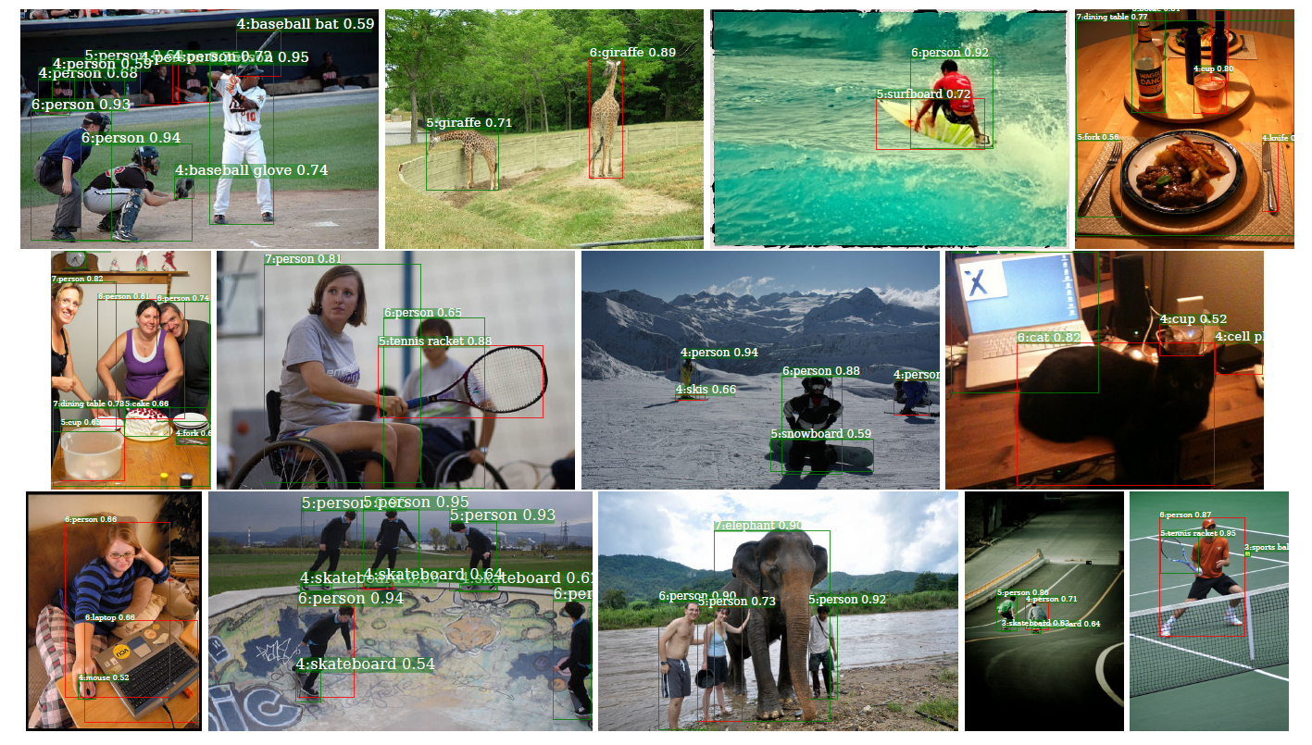
Qualitative Results – Online Feature Selection

Slide 35
References
Ren, Shaoqing, et al. "Faster r-cnn: Towards real-time object detection with region proposal networks." Advances in neural information processing systems. 2015.
Liu, Wei, et al. "Ssd: Single shot multibox detector." European conference on computer vision. Springer, Cham, 2016.
Lin, Tsung-Yi, et al. "Feature pyramid networks for object detection." Proceedings of the IEEE Conference on Computer Vision and Pattern Recognition. 2017.
Lin, Tsung-Yi, et al. "Focal loss for dense object detection." Proceedings of the IEEE international conference on computer vision. 2017.
Huang, Lichao, et al. "Densebox: Unifying landmark localization with end to end object detection." arXiv preprint arXiv:1509.04874 (2015).
Yu, Jiahui, et al. "Unitbox: An advanced object detection network." Proceedings of the 24th ACM international conference on Multimedia. ACM, 2016.

Slide 36
Takeaway
Feature selection based on semantics is the key!
FSAF module
anchor-free branch
instance
anchor-free branch
feature selection
anchor-free branch
feature pyramid

Slide 37
Thanks!
Welcome to our poster #61 on Tuesday (06/18) morning!

Slide 38
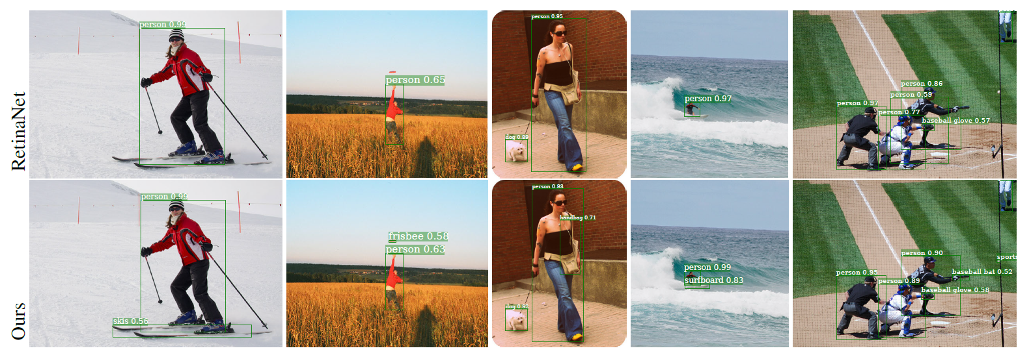
Qualitative Results

